Slide 1
The Weaponization of Data Voids
Anthony Lahna, Vimal Vinod, Patricia Lennon, Maurice Smith, Ayo Obisesan
Notes:
Maurice

Slide 2
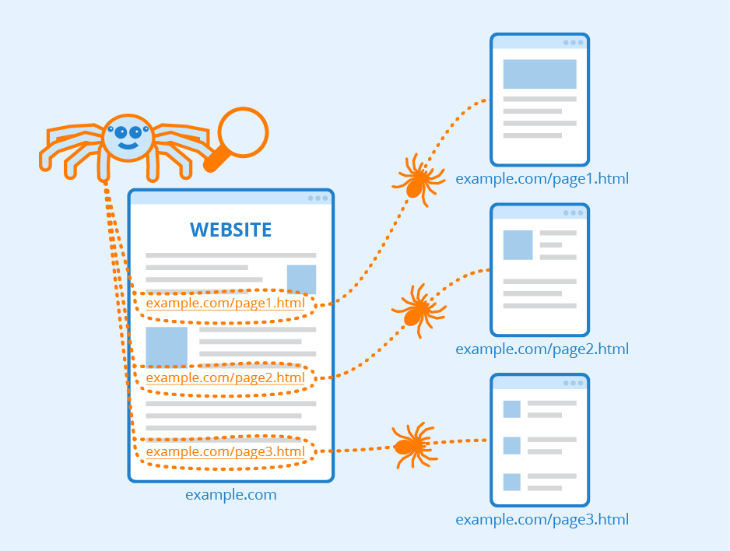
A Quick Review of Search Engines
Search Engines make use of the following processes:
Web Crawling: A “spider” follows links from one website to the next
Indexing: Storing the information found by the “spiders” in a database
Searching: What happens when you search (high relevance to low) based on algorithms
Searching can be broken down into:
Analyzing the search word
Choosing matches to keywords → Paid vs Organic
Ranking them based on some algorithm
Displaying the results
Notes:
Maurice

Slide 3
So, what is a data void anyway?
Data voids are search engine queries that have little to no results
This means that the search engine has not found much information on that search so little to no data that can then be displayed
Data voids allow the displaying of “low quality” and/or “low authority” results
Low Quality: The information is not factually correct → Misinformation
Low Authority: The information does not come from a reputable/known source
They can be created naturally or via manipulation
Notes:
Maurice

Slide 4
Activity:
Try to find a search term with the least number of results in Google
Groups of 4-5
No Random Gibberish! The search term must be actual English.
Good: “cats vs dogs”
Bad: “mdfkjdhfkjshfdjvmgdfb”
Create a document to keep track of this in your group
Discussion: Paste the term that you found to have the least number of search results. What do you notice about the search you did?
shorturl.at/jrxEG
Notes:
Patricia
5 minute timer to come up with answer, put it in the jamboard with number of results, discuss with class

Slide 5
Problems With Data Voids
Misinformation - searches with data voids can often lead to misinformation for the party making the search
Information Manipulation - searches with data voids can be targeted to produce results with biased information
Malicious Intent - searches with data voids can be targeted to product results that harm others
Notes:
Ayo

Slide 6
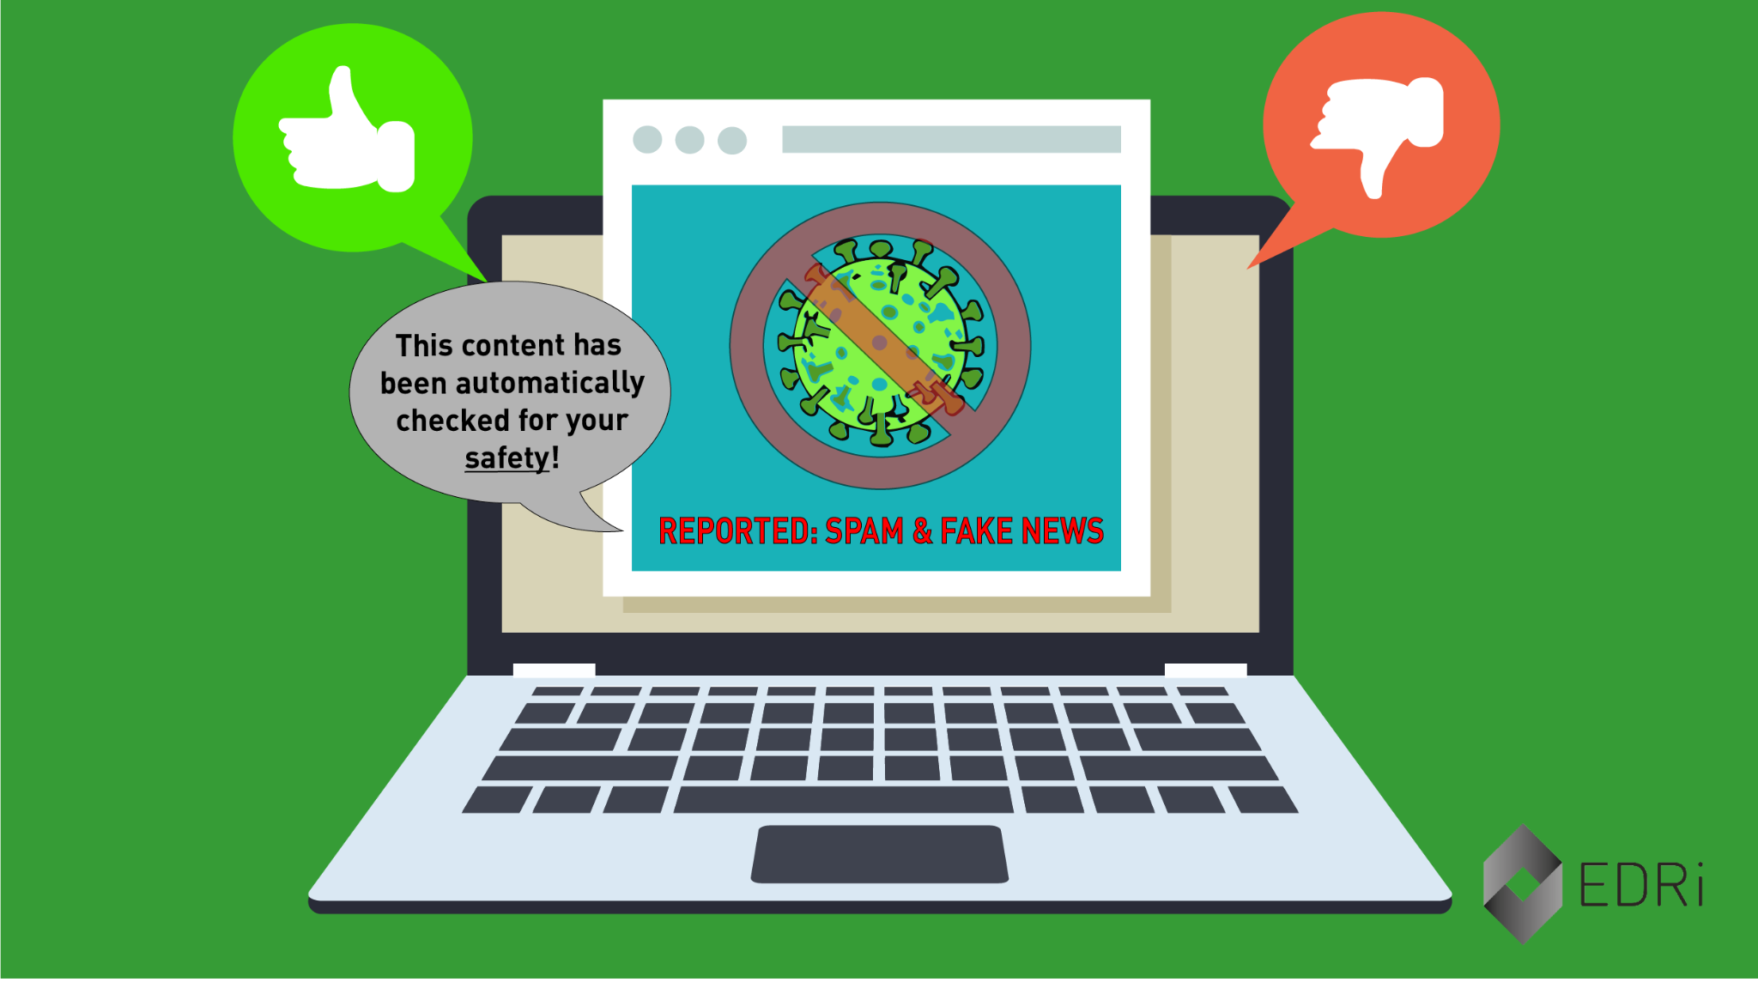
Misinformation vs. Censorship
Misinformation: false or inaccurate information
Censorship: the suppression of accurate information
While nuanced, it is important to understand how these two terms work together
Notes:
Ayo

Slide 7
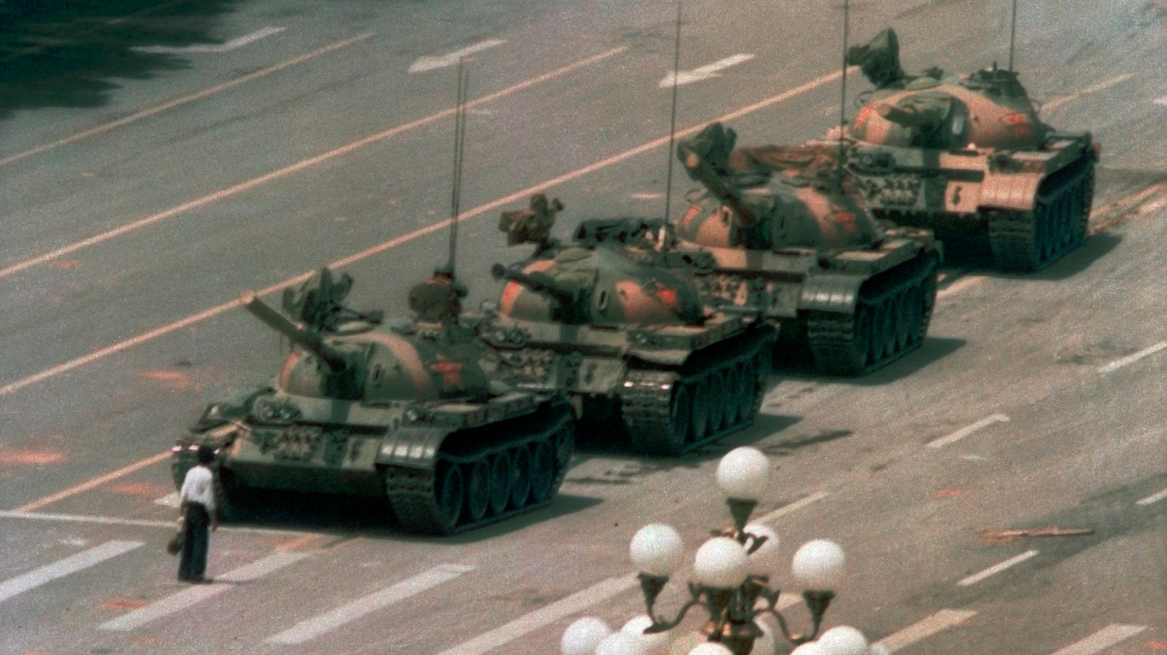
Example: Tiananmen Square
The June 4th incident, also known as the Tiananmen Square Massacre, was the result of the Chinese military moving to stop a series of protests
Protests began in response to the death of Hu Yaobang and the desire for political liberalization primarily by young Chinese citizens
The Chinese government has since fully censored the topic, creating a data void
Video here
Notes:
Patricia

Slide 8
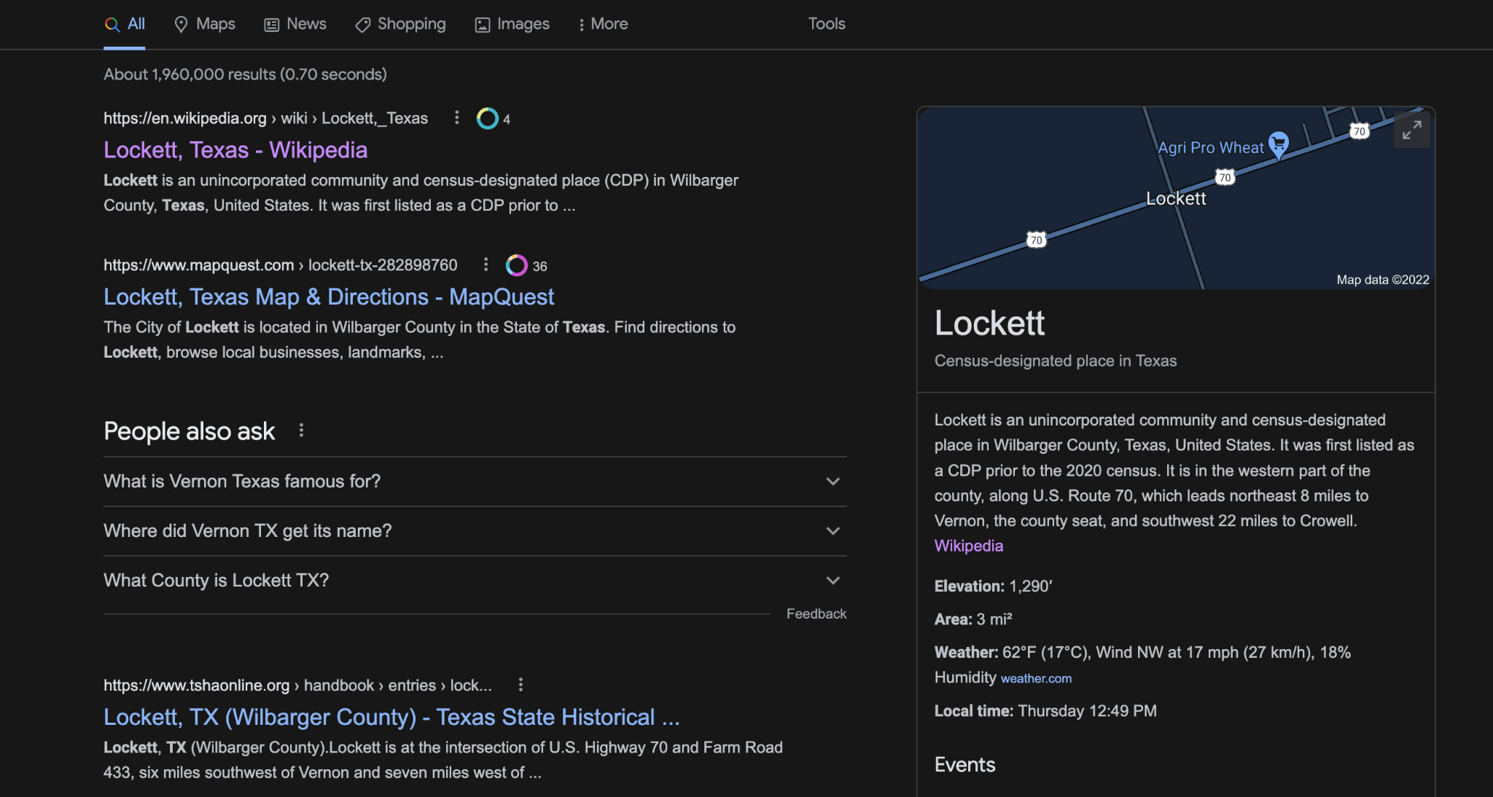
More Information on Data Voids
Even queries that seem to have a lot of search results (ex. 60,000 results) are vulnerable to being exploited
Many of the top search results for queries with that size of results are what is known as “placeholder content” - algorithmically generated
Accuweather.com
Mapquest.com
These sites have content users want but they can easily be supplanted
Data Voids are therefore, found anywhere with search functionality → YouTube, Instagram, Facebook, Reddit, etc.
Notes:
Vimal

Slide 9
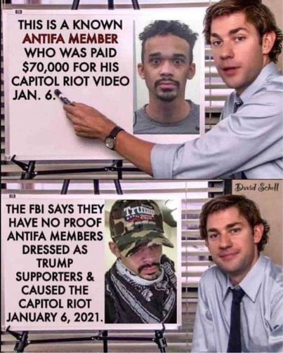
The Types of Data Voids - Breaking News
One of the most common and most impactful forms of data voids
When some important event happens anywhere in the world, there is a rush of people who are searching that term for the first time - gradually close
Example: Sutherland Springs Shooting - November 5, 2017
Connected to Antifa
Example: January 6th Insurrection - January 6, 2021
Shortly after the insurrection began, reports of Antifa involvement began to be circulated around the web
Notes:
Vimal

Slide 10
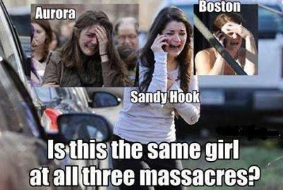
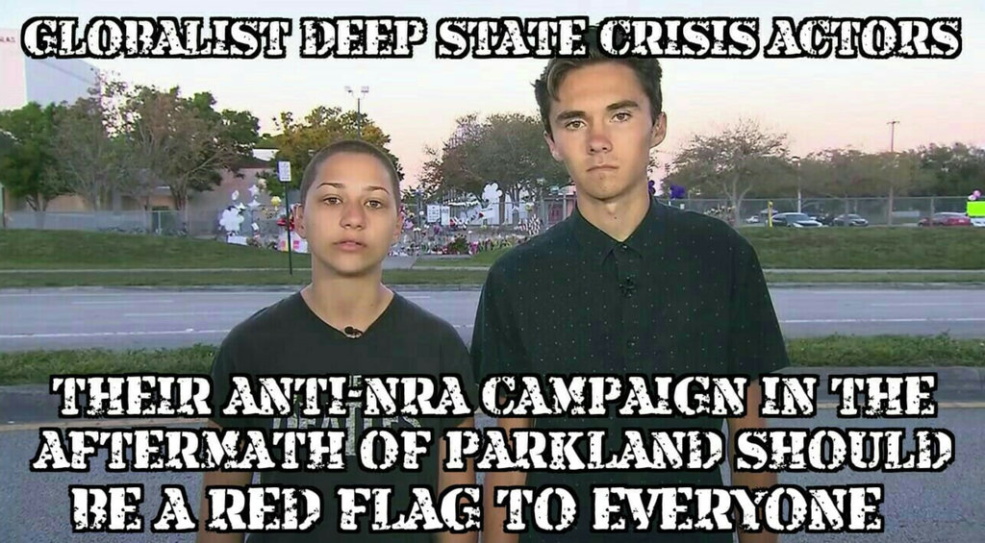
The Types of Data Voids - Strategic New Terms
This type of data void involves the creation of new terms around which a narrative can be built which can be then propagated to the mainstream (aka fake news)
Longer-term form of data void - can take years to be built up
Example: Sandy Hook to Parkland to Now
Converged around the idea that the victims of these shootings were paid actors
Took over the term “crisis actor”
Used to mean an actor playing a person playing a victim in disaster simulations
Emanuel African Methodist Episcopal Church Shooting - “black on white crime”
Notes:
Vimal
Shortly after this mass murder, malicious actors throughout the internet began posting tweets, articles, and posts tying the shooter to far-left organizations like Antifa

Slide 11
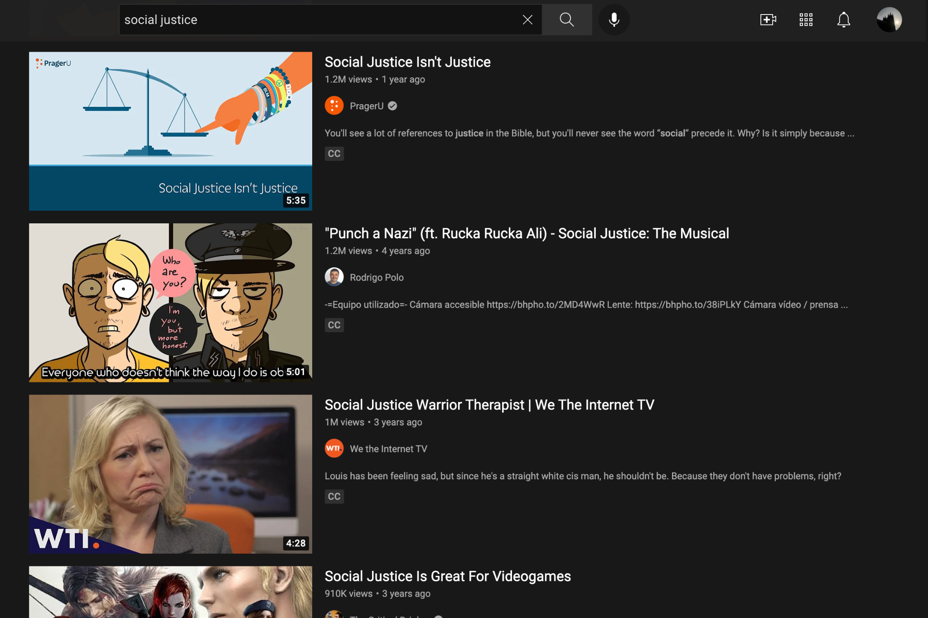
The Types of Data Voids - Outdated Terms
This type of data void emerges from search terms that are no longer in use being co-opted by media manipulators
There is a gap between when content producers stop making content about a topic and when users stop searching for that topic
Example: “Social Justice” on Youtube
A drop in the number of content producers using that term but no such drop in user searches
Lead to promotion of content that was opposed to social justice and feminism → Associations with social justice warrior → Improved now
Notes:
Ayo

Slide 12
The Types of Data Voids - Problematic Queries
This type of data void is where queries about problematic/fraught topics that return problematic results continue to return them unless they are outranked by reputable/credible sources
Example: “Did the Holocaust happen”
This term and others like it lead to results that continue to play host to bad information
https://truehistory248416267.wordpress.com/2017/12/08/holocaust-against-jews-is-a-total-lie-proof/ - This was found on the second page of a Bing search - Holocaust Denial
https://jamesfetzer.org/2022/02/mary-maxwell-the-sandy-hook-school-shooting-did-not-happen-period/ - Sandy Hook Shooting Denial
Notes:
Patricia

Slide 13
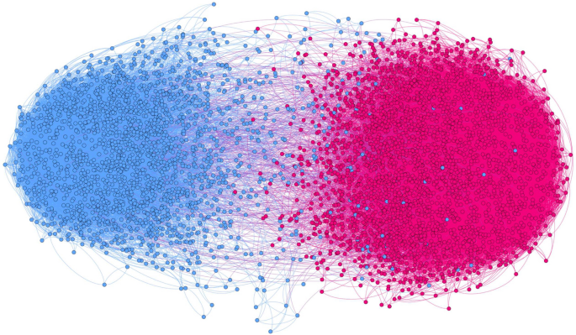
The Types of Data Voids - Fragmented Concepts
This type of data void seeks to get rid of connections between concepts that are related
Allows for the creation of “echo chambers” where people looking for the same information are lead down entirely different paths based on their specific search
Leads to accusations of bias in search
Makes Google and other search providers less likely to bridge those gaps between related concepts when they try to fix it
Extremely dangerous in the political climate we are in today because people rarely leave echo chambers
Notes:
Anthony Lahna 45- 1 mins

Slide 14
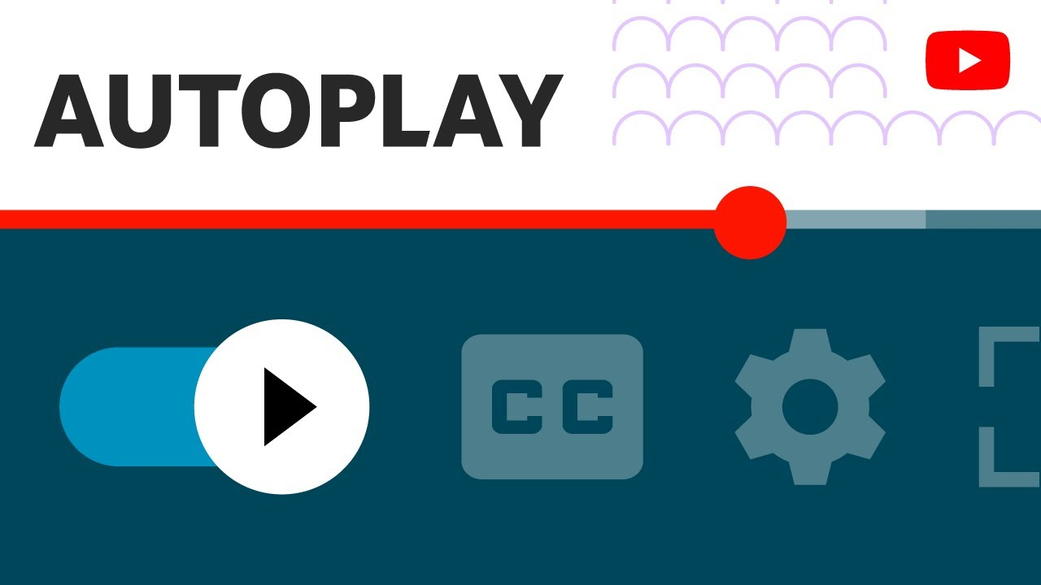
Search Adjacent Recommendation Systems and Data Voids
Search Adjacent Recommendation Systems are the systems that encourage users to consume additional content by suggesting new content that the user might be interested in
Netflix recommendations and autoplay
Youtube autoplay
Spotify recommendations
Auto-Suggestions in Google Search and Bing, etc
These recommendation systems can be exploited by malicious actors to lead people to their misinformation
Youtube recommendations of anti-vaccine content - Only recently cracked down on
Notes:
Anthony Lahna

Slide 15
Solutions
Because data voids are so hard to identify and there are so many of them around the internet, getting rid of them all is a tall order
Some solutions include:
Getting rid of the autoplay feature on some videos or sections of websites - YouTube Kids
Supporting content creators making high quality informative content
Improve reporting features to allow users to help identify bad information
Emphasizing credible information on topics vulnerable to being taken advantage of by data manipulators
Education about data voids so people spend extra time to ensure they’re receiving accurate and safe information
This is a problem that will never truly go away but search engine platforms need to continue working on curbing/curtailing it
Notes:
Anthony Lahna

Slide 16
Kahoot!
This is our wrap-up activity to help reinforce the topics you learned today!
Please open Kahoot and use whatever name you want (keep it appropriate)
There is a prize for this activity - Candy!!!

Slide 17
Bibliography
https://apo.org.au/sites/default/files/resource-files/2019-10/apo-nid265631.pdf
https://moz.com/beginners-guide-to-seo/how-search-engines-operate
https://www.ischool.berkeley.edu/news/2020/data-voids-social-networks-are-spreading-misinformation-and-causing-harm
https://www.niemanlab.org/2019/11/watch-your-language-data-voids-on-the-web-have-opened-a-door-to-manipulators-and-other-disinformation-merchants/
https://slate.com/technology/2020/11/data-voids-election-misinformation.html
https://datavoids.2020.bkmla.org/#Part1
https://securingdemocracy.gmfus.org/data-void-china-covid-disinformation/
https://medium.com/@Assembly_Program/into-the-voids-exploring-data-voids-af101e228784
https://cyber.fsi.stanford.edu/news/bing-search-disinformation
https://medium.com/in-search-of-search/exploiting-digital-il-literacy-extreme-right-manipulations-of-the-logics-of-search-engines-e16fc02d7020
https://www.britannica.com/event/Tiananmen-Square-incident

